Slide 1

Mobile Applications for customer-initiated merchant payment
By iMoSyS - Malawi

Slide 2
Introduction
iMoSyS exists to provide industry leading responses to socio economic challenges through our expertise in Engineering & Information Technology with the goal of making life better.
iMoSyS joined the Mojaloop community as a system integrator for the COMESA Business Council Malawi – Zambia PoC of the Digital Retail Payments Scheme

Slide 3
iMoSyS in the Community
iMoSyS has contributed code to PI 23, specifically with DFSP onboarding in the Merchant Payments workstream.
iMoSyS has endeavored to build a mobile apps that allow a customer from one DFSP to make a payment to a merchant with another DFSP through Miniloop.

Slide 4
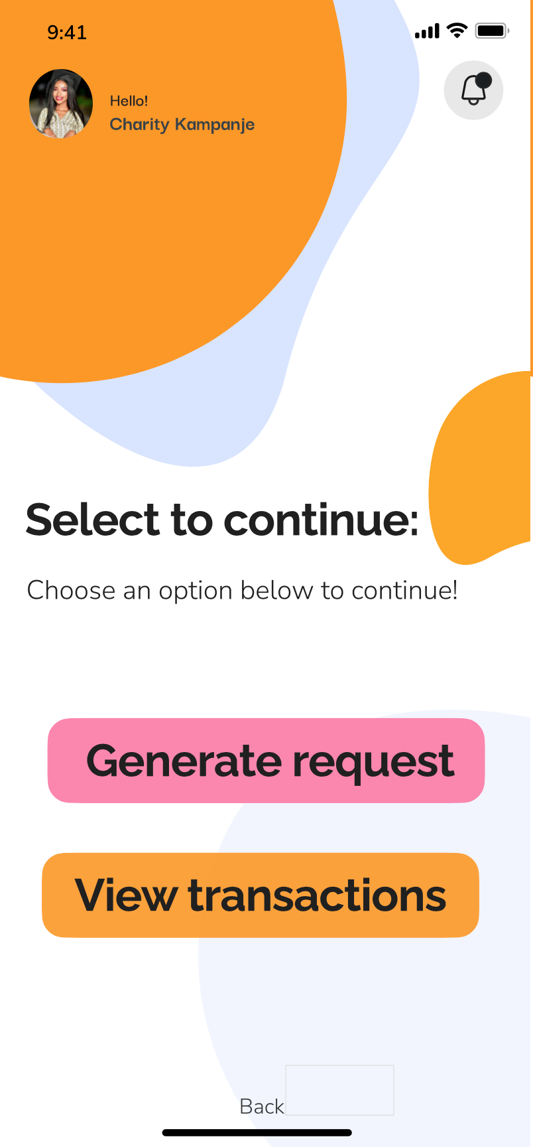
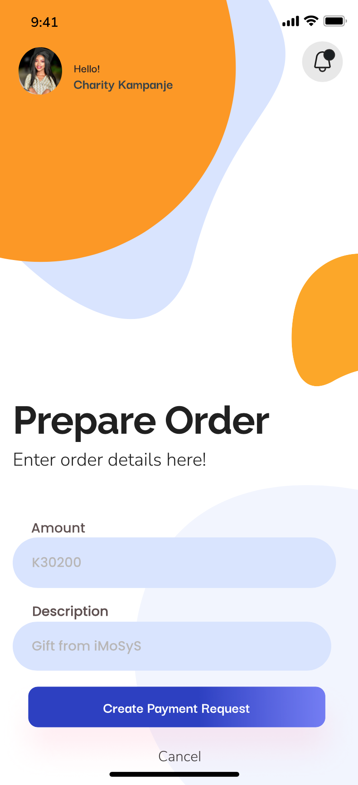
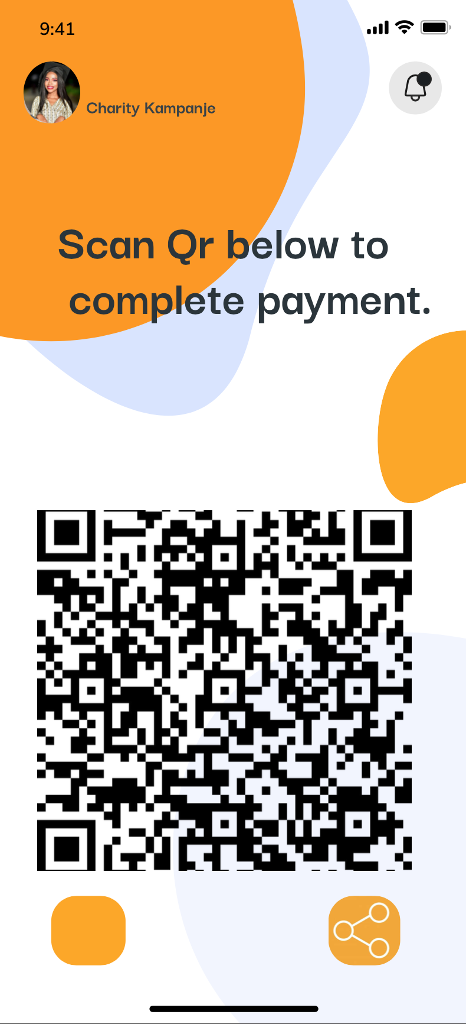
Mobile App for Payer Initiated Payments
Merchant App

Slide 5
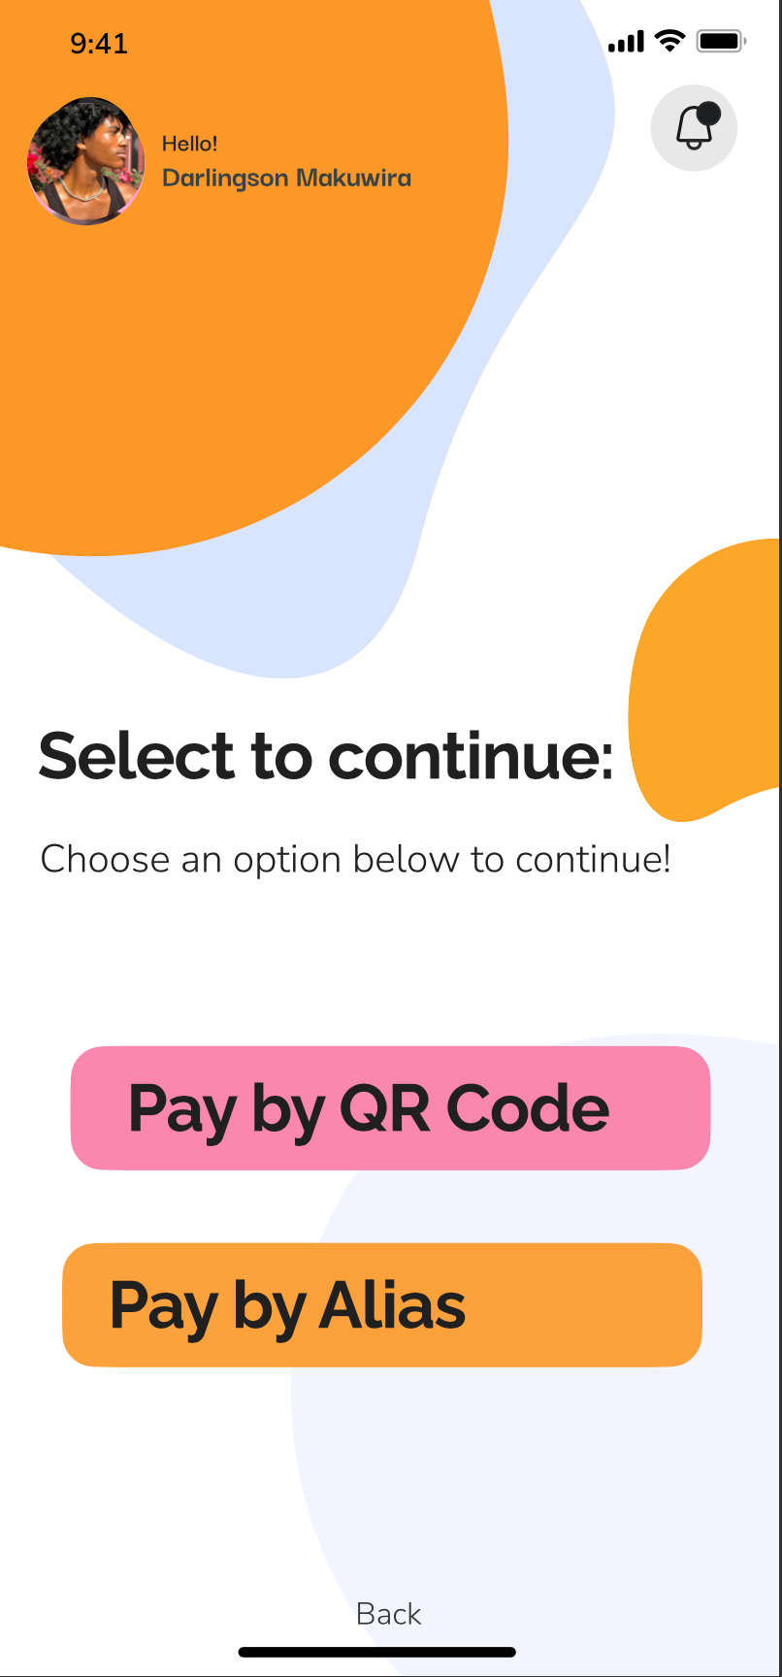
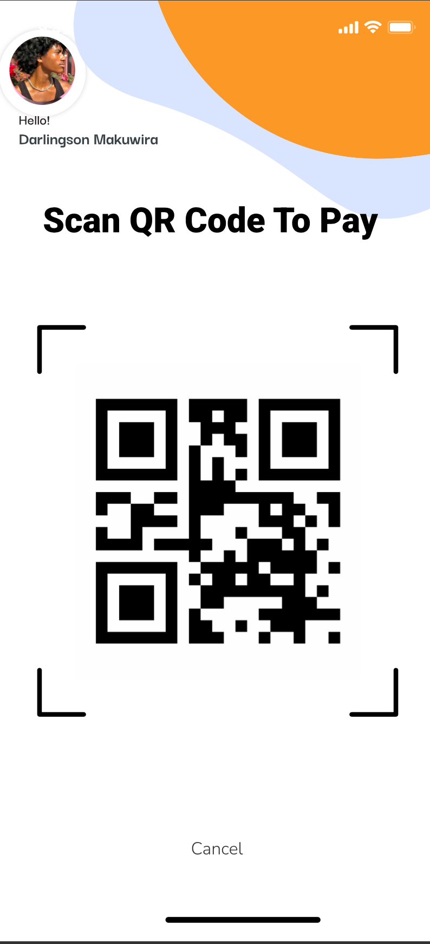
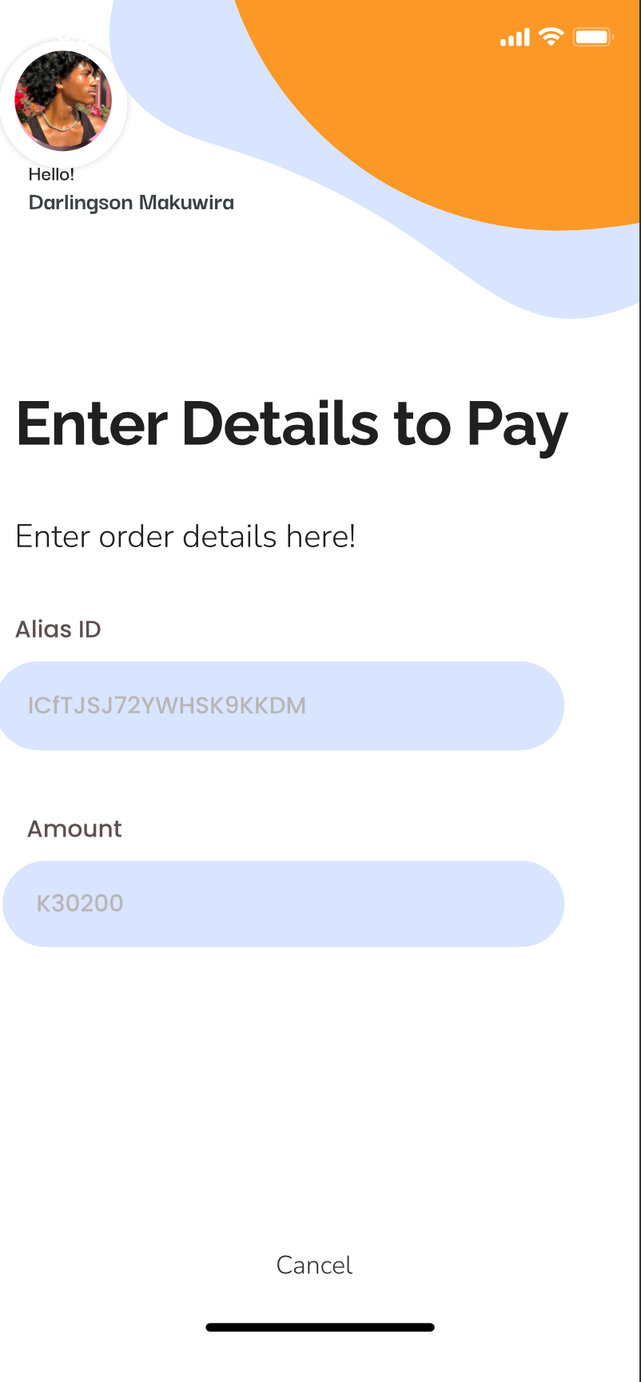
Mobile Apps for Customer-initiated merchant payments
Customer App

Slide 6
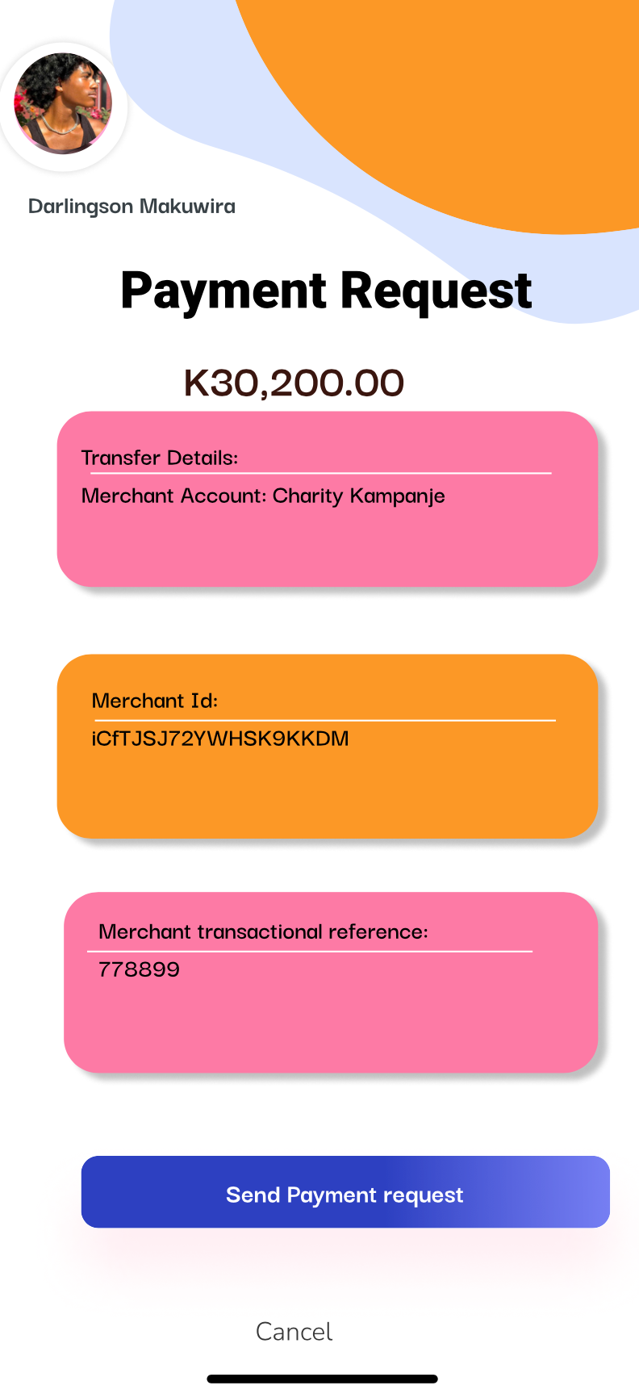
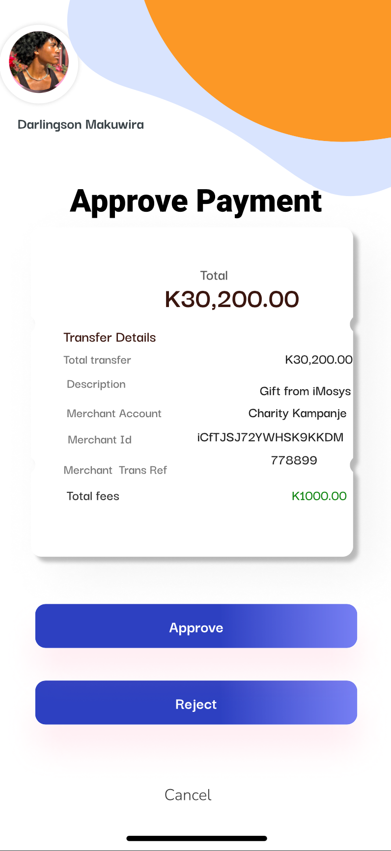
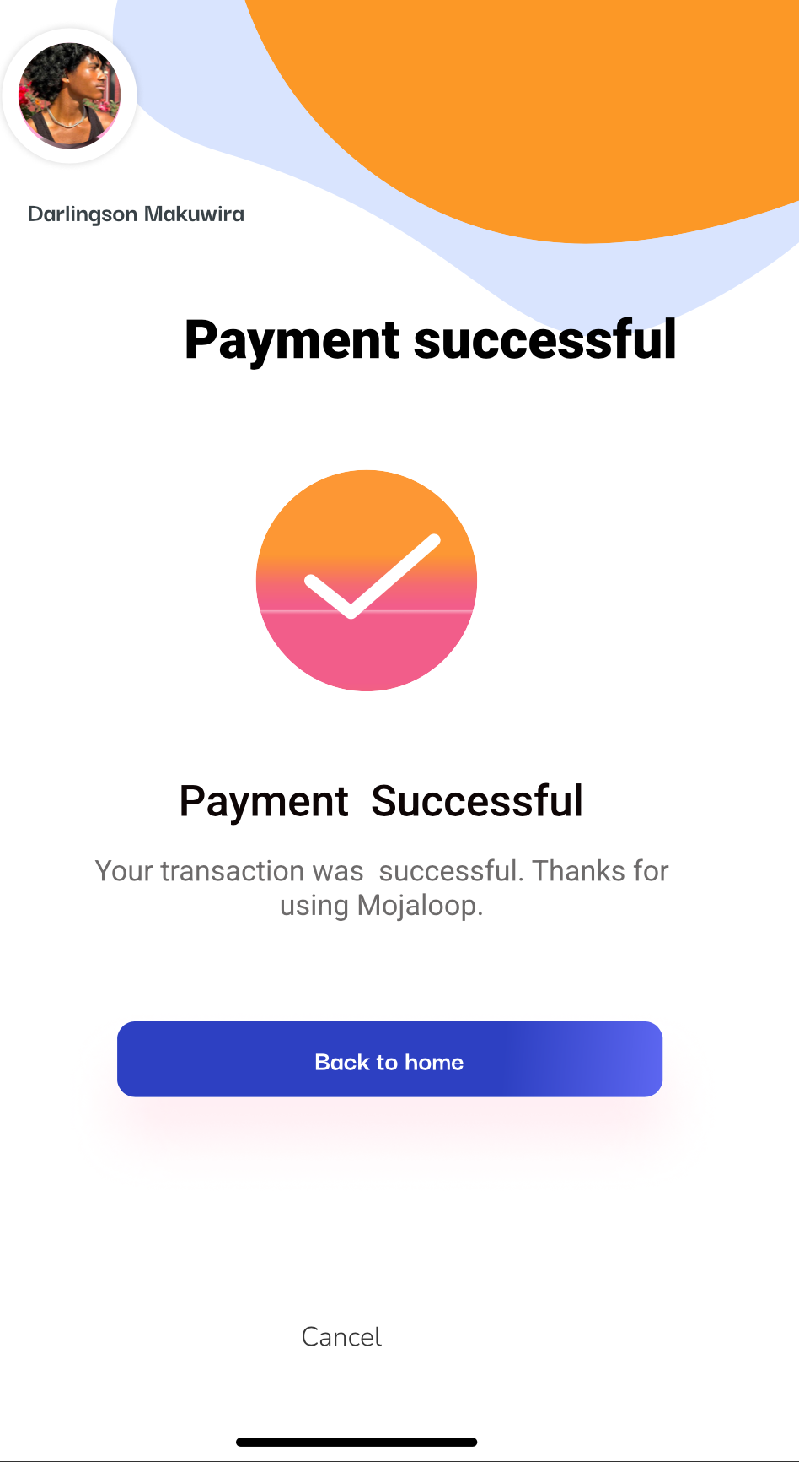
Mobile App for Payer Initiated Payments
Customer App

Slide 7
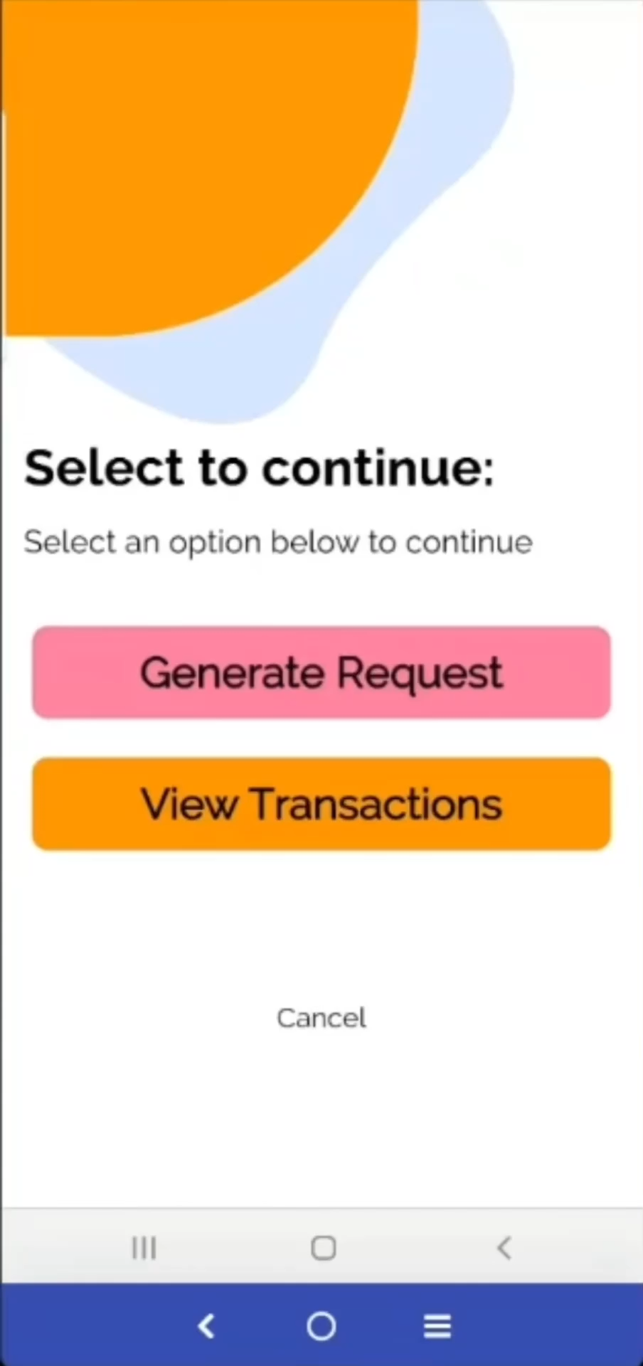
Mobile App for Payer Initiated Payments
Demo

Slide 8
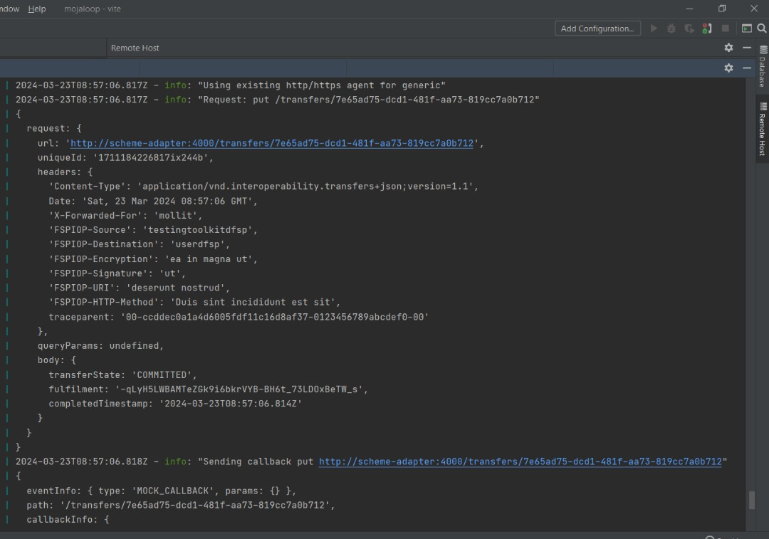
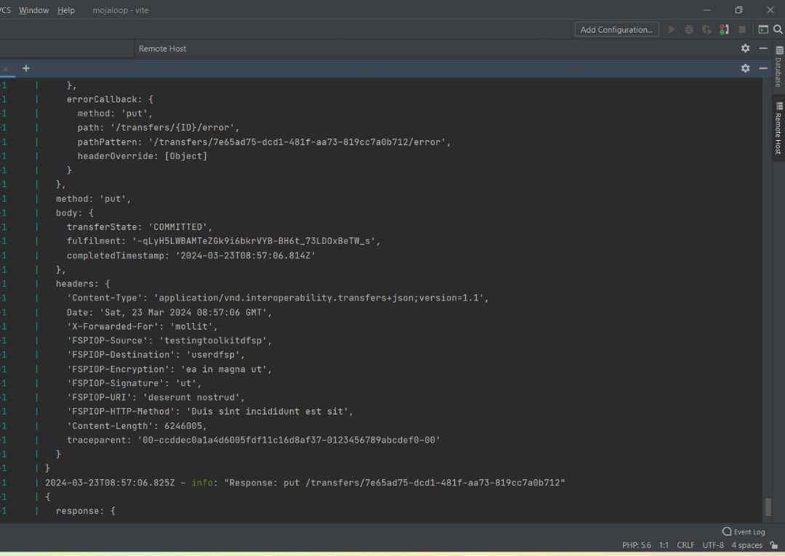
Mobile App for Payer Initiated Payments
System Logs to show that the transfer happened in the switch, add image

Slide 9
Mobile App for Payer Initiated Payments
Next Steps
Feedback gathering
Bug fixing
Feature enhancements
User testing
Incorporating real data.
Continuous improvement

Slide 10
Thank You!

